Slide 1
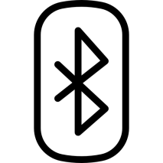
BLUETOOTH COMMuNICATION
Cansu Ceylan
Leyla Baykalı

Slide 2
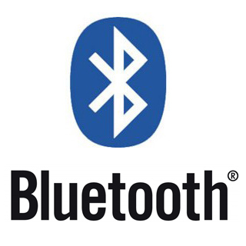
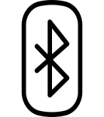
What is Bluetooth?
The rapid transfer of data between short distances over the wireless network takes place via Bluetooth technology.
Bluetooth provides communication thanks to short-range radio frequency. Communication speed is 2.4 Ghz.

Slide 3
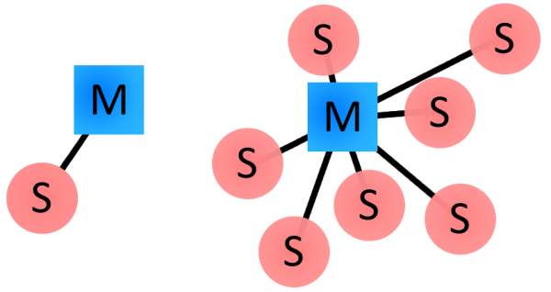
How Bluetooth Works
The Bluetooth protocol operates at 2.4GHz in the same unlicensed ISM frequency band. There is a standardized set of rules and specifications that differentiates it from other protocols.
Masters, Slaves and Piconents
Bluetooth networks use a master/slave model to control when and where devices can send data.

Slide 4
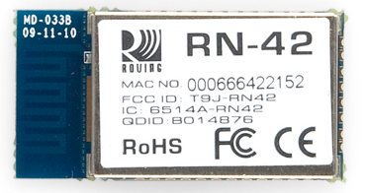
Bluetooth Addresses and Names
Every single Bluetooth device has a unique 48-bit address, commonly abbreviated BD_ADDR.
The most-significant half (24 bits) of the address is an organization unique identifier (OUI), which identifies the manufacturer.
The lower 24-bits are the more unique part of the address.

Slide 5
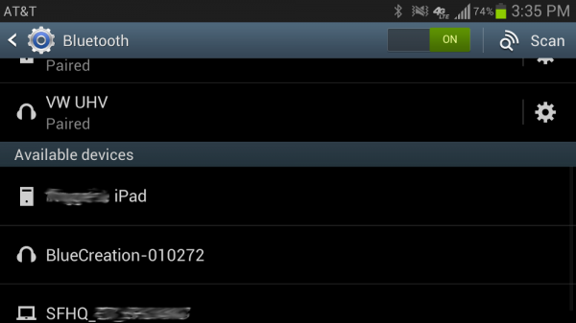
The user can name the bluetooth device. This makes it easy to find the device.

Slide 6
Connection Process
Three progressive states:
1. Inquiry – Devices that will connect for the first time discover each other
2. Paging – The process of forming a connection between two Bluetooth devices.
3. Connection – Can be active or in sleep mode
• Active Mode
• Sniff Mode
• Hold Mode
• Park Mode

Slide 7
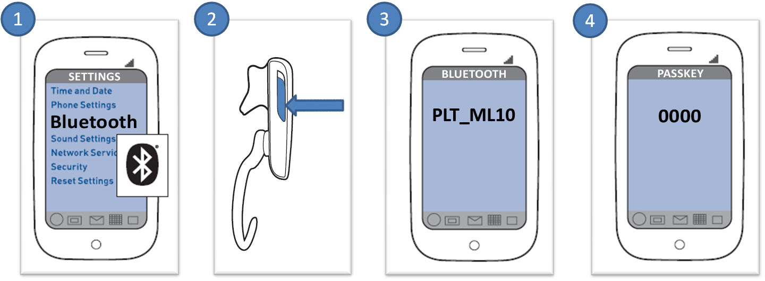
Bonding and Pairing
If two bluetooth devices are paired, they are connected when they approach.
When devices pair up, they share their addresses, names, and profiles, and store them in memory.
Pairing requires an authentication process where a user must verify the connection between the devices.

Slide 8
Power Classes
The transmit power, and therefore range, of a Bluetooth module is defined by its power class. There are three defined classes of power:
Some modules are only able to operate in one power class, while others can vary their transmit power.
Class Number | Max Output Power (dBm) | Max Output Power (mW) | Max Range
Class1 | 20 dBm | 100 mW | 100 m
Class2 | 4 dBm | 2,5 mW | 10 m
Class3 | 0 dBm | 1 mW | 10 cm

Slide 9
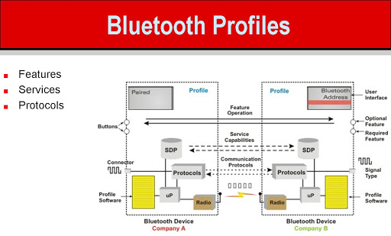
Bluetooth Profiles
Bluetooth profiles are additional protocols that build upon the basic Bluetooth standard to more clearly define what kind of data a Bluetooth module is transmitting. While Bluetooth specifications define how the technology works, profiles define how it’s used.

Slide 10
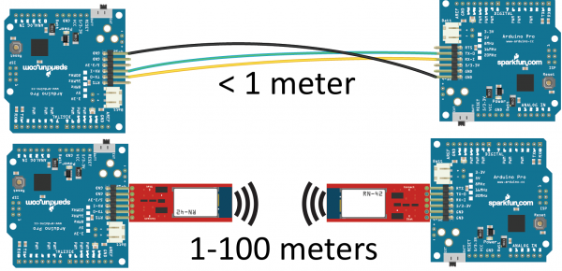
Serial Port Profile (SPP)
Replacing a serial communication interface with Bluetooth, SPP is the profile. SPP is great for sending bursts of data between two devices.

Slide 11
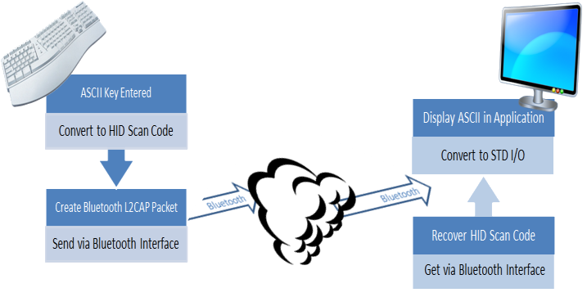
Human Interface Device (HID)
Bluetooth's HID profile is actually a riff on the HID profile already defined for human input USB devices.

Slide 12
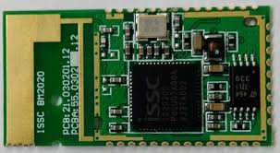
Hands-Free Profile (HFP) and Headset Profile (HSP)
Bluetooth earpieces usually use headset profile (HSP) or hands-free profile (HFP). It implements a few features on top of those in HSP to allow for common phone interactions (accepting/rejecting calls, hanging up, etc.) to occur while the phone remains in your pocket.

Slide 13
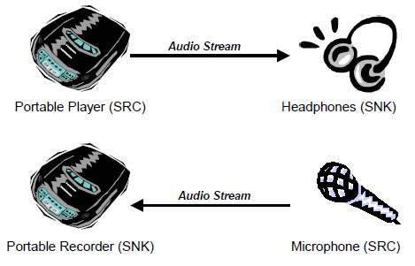
Advanced Audio Distribution Profile (A2DP)
Advanced audio distribution profile (A2DP) defines how audio can be transmitted from one Bluetooth device to another.

Slide 14
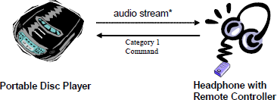
A/V Remote Control Profile (AVRCP)
The audio/video remote control profile (AVRCP) allows for remote controlling of a Bluetooth device. It’s usually implemented alongside A2DP to allow the remote speaker to tell the audio-sending device to fastforward, rewind, etc.

Slide 15
Common Versions
Here's a rundown of the commonly encountered Bluetooth
versions:
Bluetooth v1.2
Bluetooth v2.1 + EDR
Bluetooth v2.1
Bluetooth v3.0 + HS
Bluetooth v4.0 and Bluetooth Low Energy(BLE)

Slide 16
Wireless Comparison
Name | Bluetooth classic | Bluetooth 4.0 Low Energy (BLE) | ZigBee | Wifi
IEEE Standard | 802.15.1 | 802.15.1 | 802.15.4 | 802.11
Frequency (GHz) | 2.4 | 2.4 | 0.868, 0.915, 2.4 | 2.4 and 5
Maksimum raw bit rate (Mbps) | 1-3 | 1 | 0.250 | 11 (b), 54 (g), 600 (n)
Typical data throughput (Mbps) | 0.7-2.1 | 0.27 | 0.2 | 7 (b), 25 (g), 150 (n)
Max (Outdoor) Range (Meters) | 10 (class 2), 100 (class 1) | 50 | 10-100 | 100-250
Relative Power Consumption | Medium | Very low | Very low | High
Example Battery Life | Days | Months the years | Months the years | Hours
Example Battery Life | 7 | Undefined | 64,000+ | 255

Slide 17


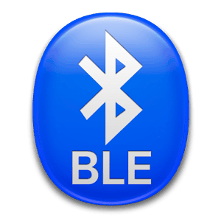
ZigBee is used for communication between complex structures.
BLE saves significant power.
WiFi is fast and flexbile, but also requires a lot of power.

Slide 18
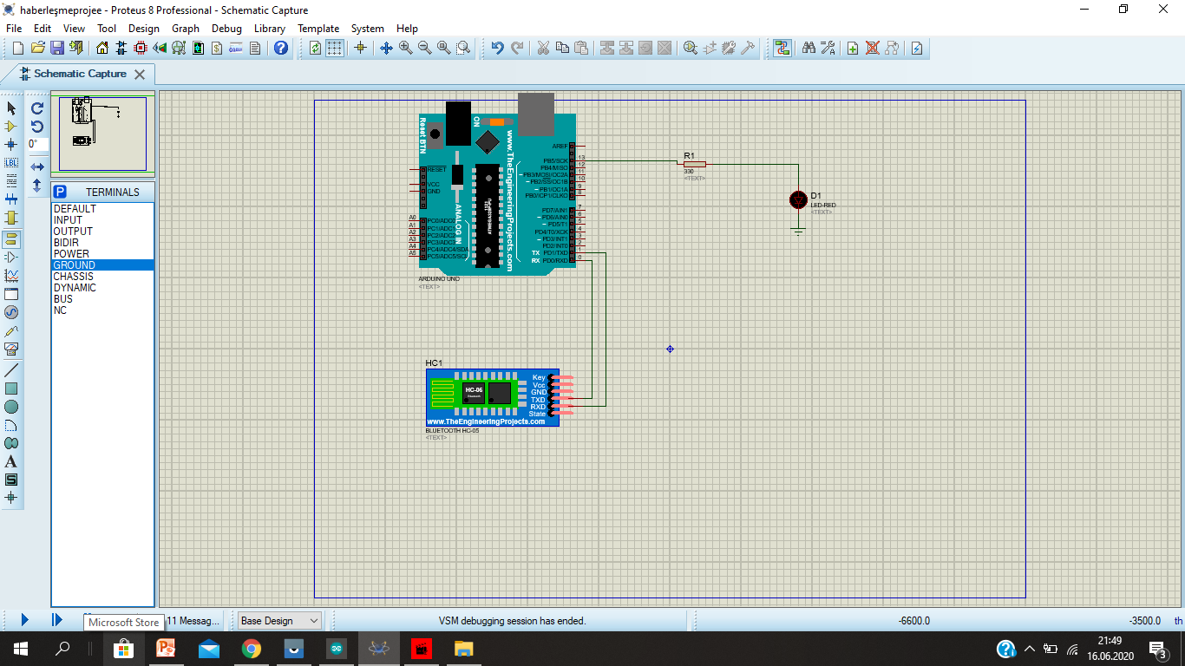
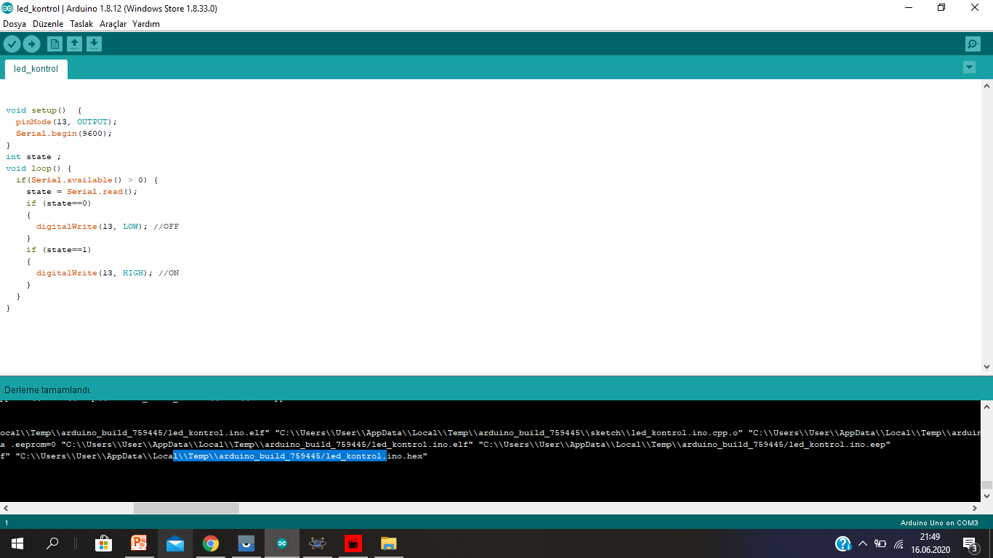
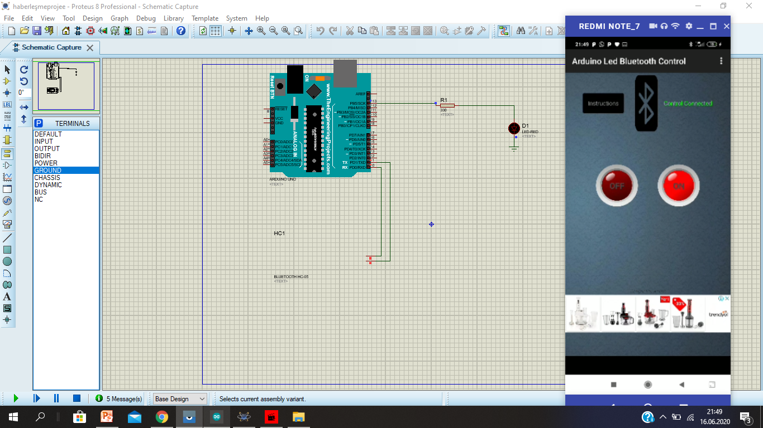
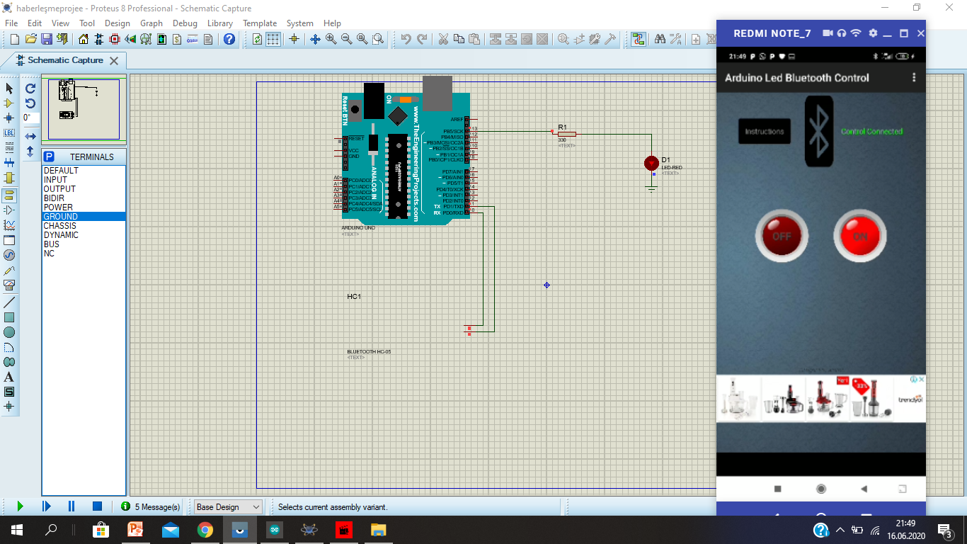
Bluetooth Communıcatıon Sımulatıon

Slide 19


